Slide 1
Object Oriented Programming Lab #08 Polymorphism in Java
ENGR. SANIYA SARIM

Slide 2
Java Polymorphism
Polymorphism means "many forms", and it occurs when we have many classes that are related to each other by inheritance.
Inheritance lets us inherit attributes and methods from another class. Polymorphism uses those methods to perform different tasks. This allows us to perform a single action in different ways.
For example, think of a superclass called Animal that has a method called animalSound(). Subclasses of Animals could be Pigs, Cats, Dogs, Birds - And they also have their own implementation of an animal sound (the pig oinks, and the cat meows, etc.):

Slide 3
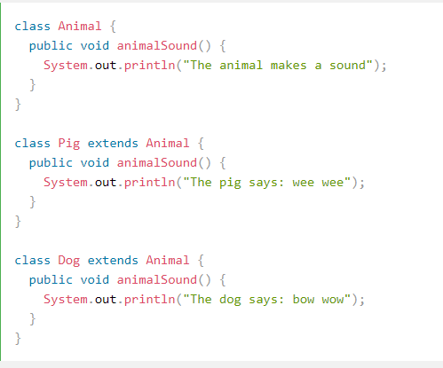
Example

Slide 4
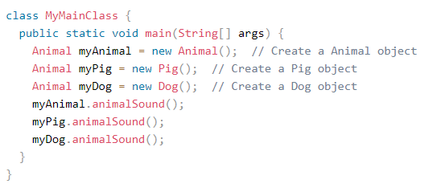
Main Method Implementation

Slide 5
Example Explanation
Polymorphism is one of the OOPs feature that allows us to perform a single action in different ways.
As you can see that although we had the common action for all subclasses sound() but there were different ways to do the same action. This is a perfect example of polymorphism (feature that allows us to perform a single action in different ways). It would not make any sense to just call the generic sound() method as each Animal has a different sound. Thus we can say that the action this method performs is based on the type of object.

Slide 6
Types of Polymorphism
There are two types of polymorphism in java:
1) Static Polymorphism also known as compile time polymorphism
2) Dynamic Polymorphism also known as runtime polymorphism

Slide 7
Compile time Polymorphism (or Static polymorphism)
Polymorphism that is resolved during compiler time is known as static polymorphism. Method overloading is an example of compile time polymorphism.
Method Overloading: This allows us to have more than one method having the same name, if the parameters of methods are different in number, sequence and data types of parameters.

Slide 8
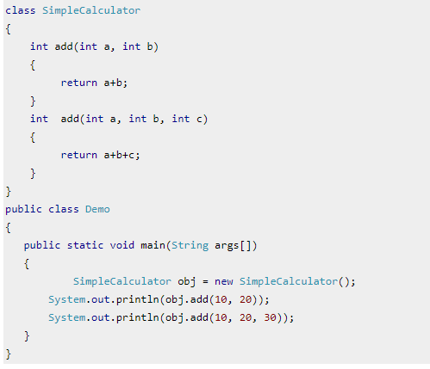
Example of static Polymorphism

Slide 9
Runtime Polymorphism (or Dynamic polymorphism)
It is also known as Dynamic Method Dispatch. Dynamic polymorphism is a process in which a call to an overridden method is resolved at runtime, thats why it is called runtime polymorphism.

Slide 10
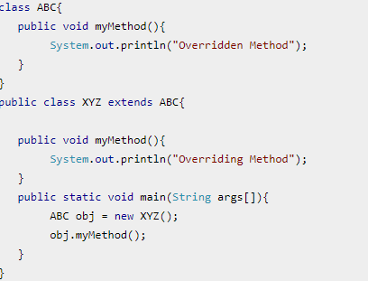
Example

Slide 11
Example Explanation
In this example we have two classes ABC and XYZ. ABC is a parent class and XYZ is a child class. The child class is overriding the method myMethod() of parent class. In this example we have child class object assigned to the parent class reference so in order to determine which method would be called, the type of the object would be determined at run-time. It is the type of object that determines which version of the method would be called (not the type of reference).

Slide 12
Output

Slide 13
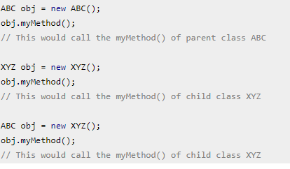
Few more overriding examples:
In the third case the method of child class is to be executed because which method is to be executed is determined by the type of object and since the object belongs to the child class, the child class version of myMethod() is called.

Slide 14
Exercise
Create an Employee class with name , address and number as private instance variables of that class
Use a constructor to initialize these instance variables
Create a mailCheck method in employee class that prints “Mailing check to employee name and address
Create a toString method that return name , address and number of the employee
Design Accessor and Mutator methods for private variables.

Slide 15
Exercise cont..
Create a salary class that inherits the Employee class with an additional private instance variable as salary.
Create a constructor to initialize the instance variables.Also make use of parent class constructor and mutator method to set the salary .
Override the mailCheck method that prints the following
“Within MailCheck of Salary class”
“Mailing check to Ali with salary 45000”
Design Accessor and Mutator method for private variable
Create a computePay method that prints” Computing salary pay for Ali”. This method should return salary after dividing it by 52.

Slide 16
Exercise cont..
Institiate two salary objects , one using salary reference and other using employee reference.
Invoke mailCheck method by using salary and employee reference both.Display a message that determines which mailCheck method has been invoked( which reference is used?).

